Slide 1
Multilingual Word Embeddings
Davey Proctor
Advanced NLP
11/1/18
Notes:
TODO:
Global Intro - check
Motivation per paper - OK
Results sections - yes
Discussion sections - good
Future work - good, in discussions
. embeddings in general
. multilinguality in general
. diversity of world languages, e.g., from ehtnologue, WALS, omniglot
. multilingual NLP tasks, e.g., language identification, machine translation, universal parsing

Slide 2
Outline
Stage setting: lightning high-level review of embeddings and multilingual word embeddings (MWEs)
Applications of multilingual embeddings - why do we care?
Multilingual embeddings, past and present
Supervised
Massively Multilingual Word Embeddings, 2016
Exploiting Similarities among Languages for Machine Translation, 2013
Unsupervised
MUSE, 2018
Unsupervised Multilingual Word Embeddings, 2018

Slide 3
MWE - Stage setting

Slide 4
Stage Setting
Monolingual word embeddings
Multilingual word embeddings

Slide 5
Monolingual embeddings - Motivation (Slides from John Brandt)
Words do not intrinsically lend themselves to numerical computations
One hot encoding and term-document matrices are sparse solutions
Embeddings are dense representations of words that convey similarity
There is a need for generalizable and universal embeddings that can be pre-trained on a large general corpus and transferred a to domain-specific corpus
Notes:
Embeddings were developed to solve the problem of sparsity caused by one-hot encoding.
Embeddings are dense representations of words that convey similarity. However, they learn biases from their training set and are rarely generalizable to new corpuses.
3rd BP.

Slide 6
Monolingual embeddings - Background
Embeddings encode words or sentences into dense vectors.
word2vec and gloVe are the most common approaches
Word2vec uses the hidden layer of a surrogate shallow neural network where the output is the prediction of a word given its surrounding words or vice versa.
gloVe is a count-based weighted least squares optimization
Embeddings are a large part of any modern NLP architecture
Sentiment analysis, classification, translation, IR
Most embeddings are pre-trained and applied with transfer learning

Slide 7
Word2vec - Skipgram vs. CBOW
Skipgram: Predicts context given word
Better with less data, better for rare words
____ _____ _____ rainy ____ _____ _____
CBOW: Predicts word given context
Faster to train than skip-gram, better accuracy for frequent words
The weather is ______ and very cold
Notes:
Word2Vec can be modelled via two different objectives and architectures.
Skip-gram predicts the context given a word. It is typically best when there is less training data (compute time) or many rare words.
CBOW (continuous bag of words), instead predicts the word given its context. It is faster to train and may have better accuracy for frequent words.

Slide 8
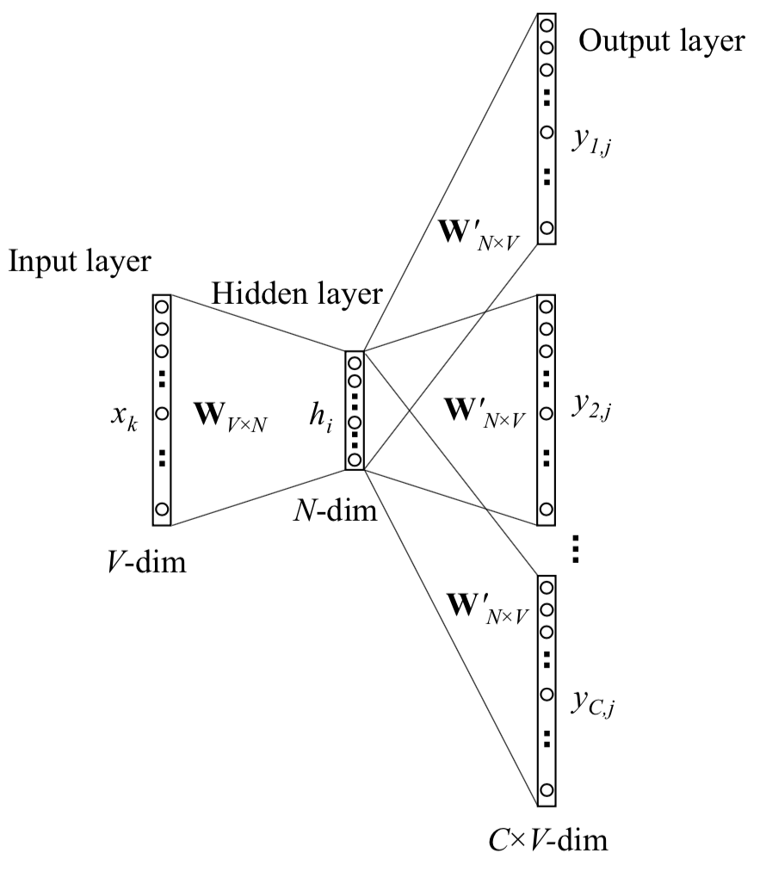
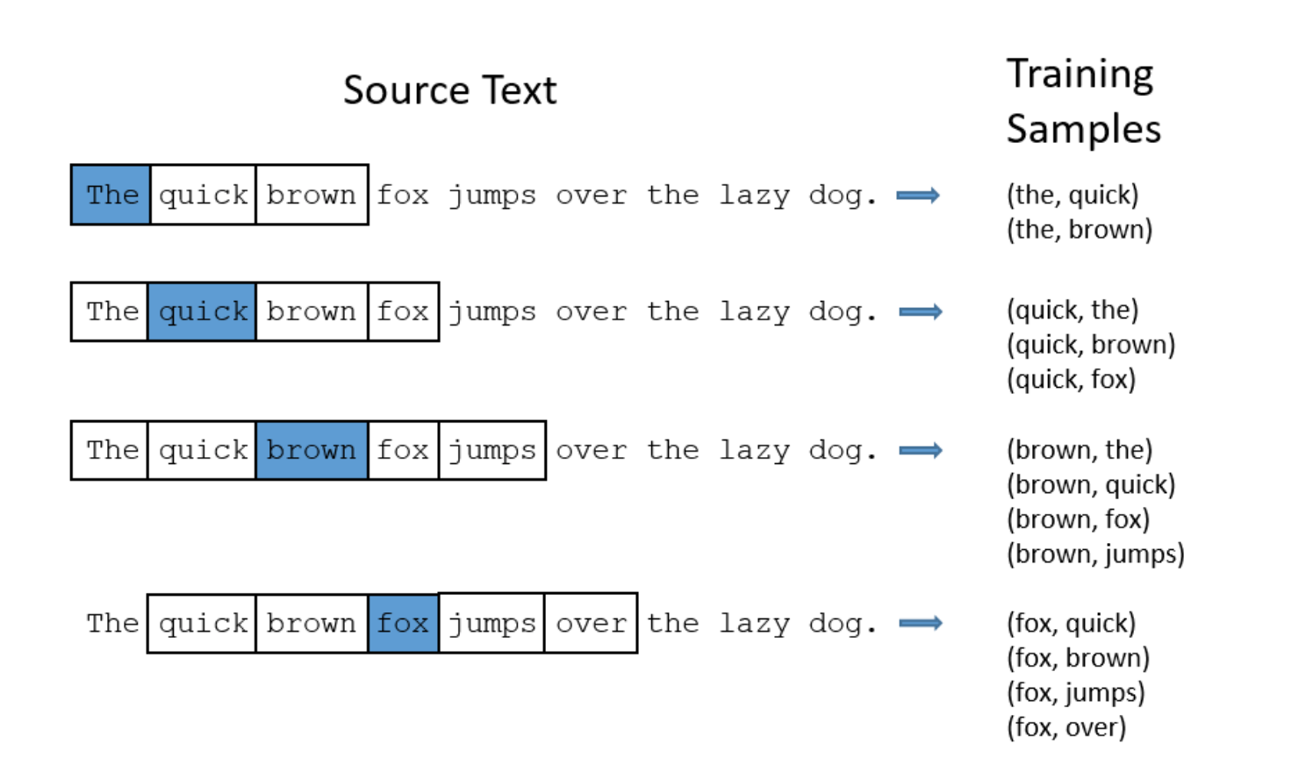
Word2vec - Skipgram
Xin Rong, 2016; http://mccormickml.com/2016/04/19/word2vec-tutorial-the-skip-gram-model/
Notes:
Here is a visual representation of the skipgram objective.
The target word is the input, and the context words are the output.
For a given window size, construct word, context pairs. The, quick, the, brown, quick, the etcetera.
For each input word in the vocabulary, construct a one-hot-encoded vector that is the input. For each training sample, maximize the conditional probability of observing the actual context word given the input word. Output C(window size) multinomial distributions representing the probability of the word being in the context of the input.
At each step, calculate the update equation based upon the loss, which is the prediction error summed across all context words in the output layer.
Xin Rong, 2016

Slide 9
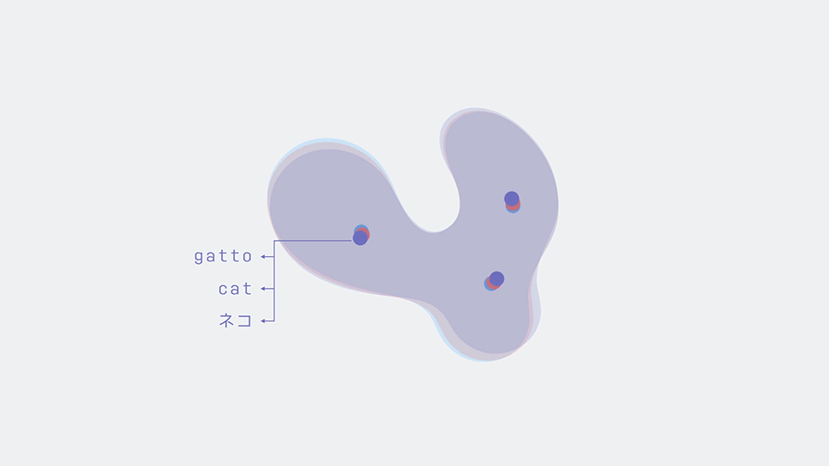
MWEs - Mapping between Two Embedding Spaces (Slides from Rui Zhang)
https://code.fb.com/ai-research/unsupervised-machine-translation-a-novel-approach-to-provide-fast-accurate-translations-for-more-languages/

Slide 10
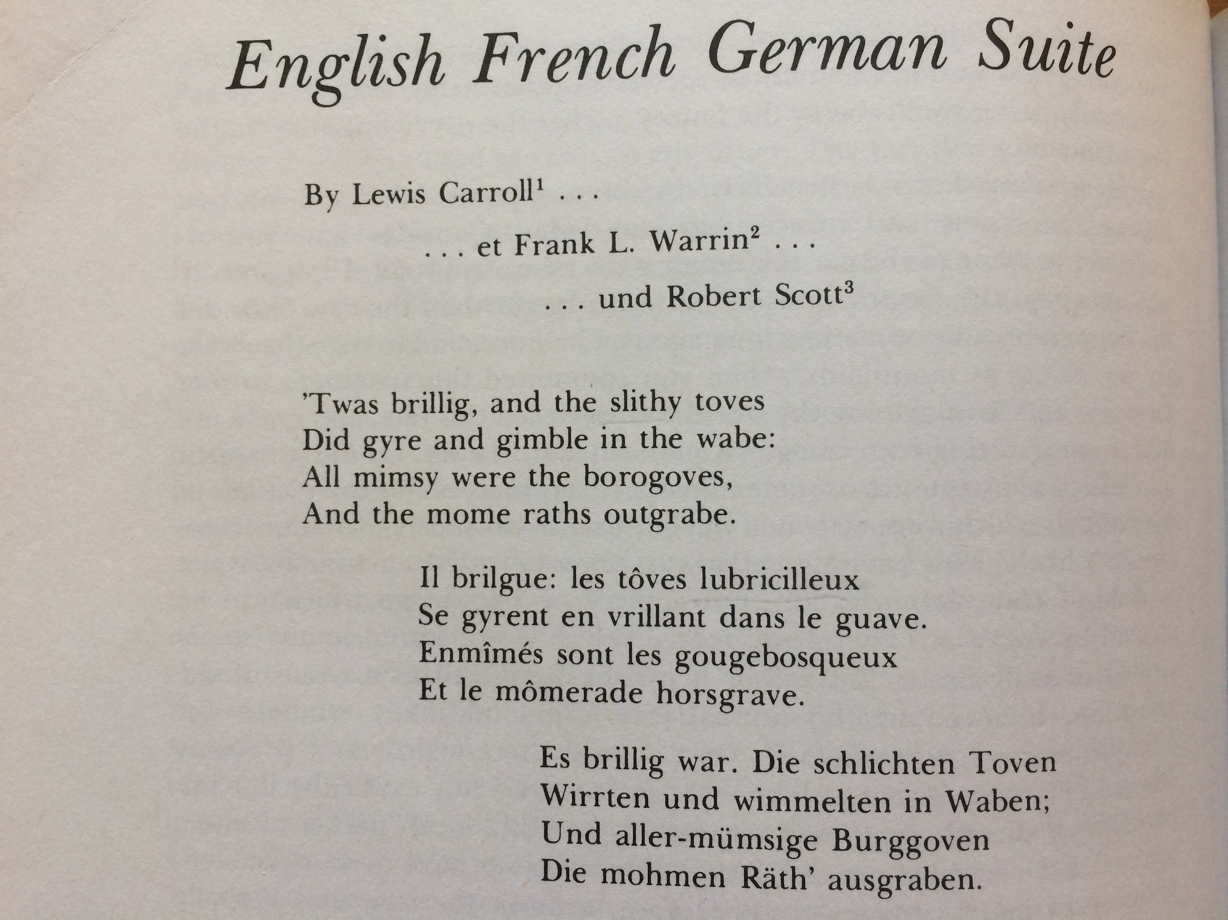
Translation - Hard problem
Godel, Escher, Bach - Douglass R. Hofstadter

Slide 11
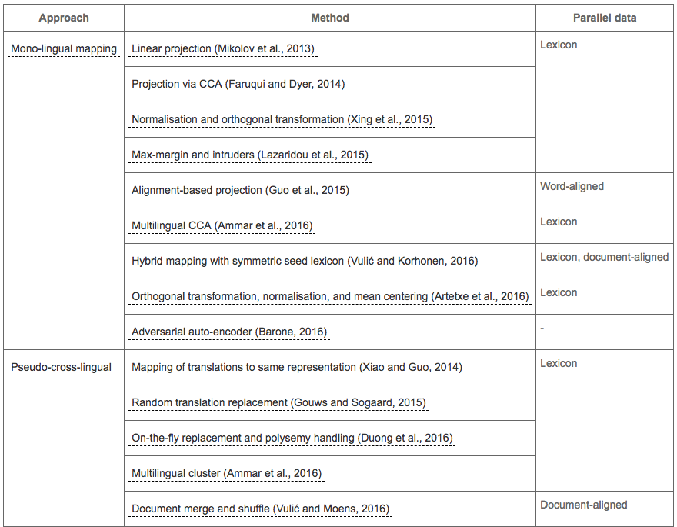
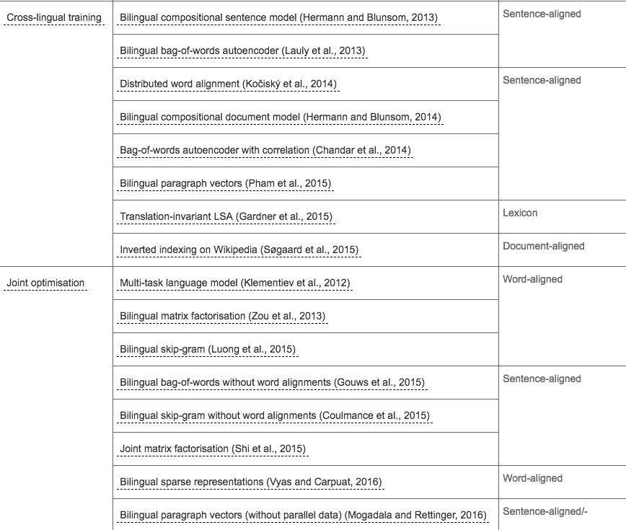
MWE - Supervised approaches
http://ruder.io/cross-lingual-embeddings/

Slide 12
MWE - Supervised approaches
http://ruder.io/cross-lingual-embeddings/

Slide 13
MWE - Applications

Slide 14
Applications
Improve existing dictionaries and phrase tables.
Improve SOTA MT and language identification systems.
Other languages, particularly low resource, do not have as much labelled data for a given NLP task (parsing, IR, dialogue systems, etc.).
Can be beneficial to map the problem into English where language tools (parsers, named entity recognizers, part-of-speech taggers, etc.) are strongest.
Unsupervised embeddings are particularly appealing: not much parallel supervision for low resource-languages.
Notes:
. multilingual NLP tasks, e.g., language identification, machine translation, universal parsing

Slide 15
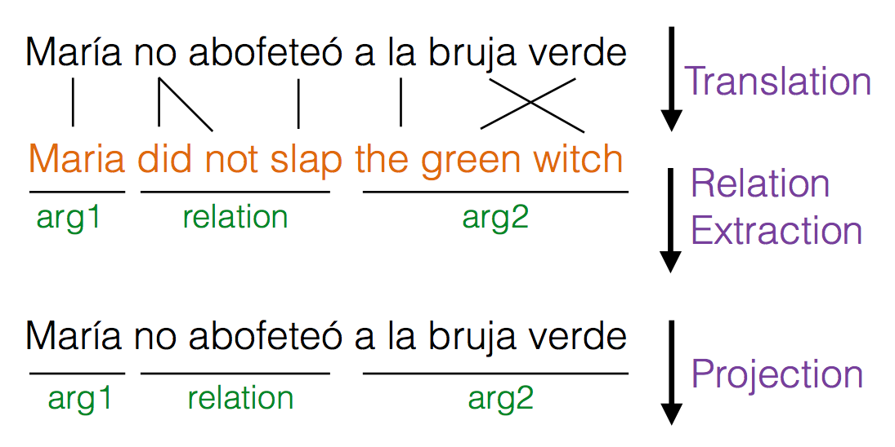
Applications - relation extraction
https://ai.googleblog.com/2015/06/a-multilingual-corpus-of-automatically.html

Slide 16
MWE - Supervised

Slide 17
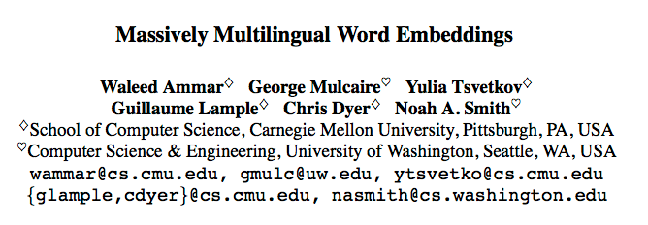
Paper 1 (2016) - Supervised MWE
Notes:
Cross lingual dictionary as supervision.

Slide 18
Paper 1 - MultiCluster
Define the clusters as the connected components in a graph where nodes are (language, surface form) pairs and edges correspond to translation entries in the dictionary.
We assign arbitrary IDs to the clusters and replace each word token in each monolingual corpus with the corresponding cluster ID, and concatenate all modified corpora.
The resulting corpus consists of multilingual cluster ID sequences. We can then apply any monolingual embedding estimator; here, we use the skipgram model from Mikolov et al. (2013a).

Slide 19
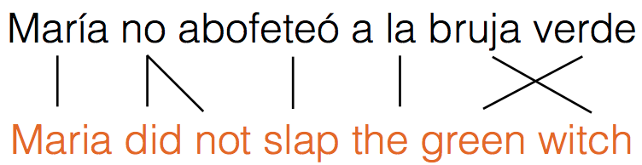
MultiCluster - Algorithm
= suppose we have these dictionary entries

Slide 20
MultiCluster - Algorithm
1
2
3
4
5
6
7
1
2
2
3
5
7
6
= suppose we have these dictionary entries

Slide 21
MultiCluster - Algorithm
1
2
3
4
5
6
7
1
2
2
3
5
7
6
New corpus:
1 2 3 4 5 6 7
1 2 2 3 5 7 6

Slide 22
MultiCluster - Algorithm
New corpus:
1 2 3 4 5 6 7
1 2 2 3 5 7 6

Slide 23
MultiCluster - Cons?
New corpus:
1 2 3 4 5 6 7
1 2 2 3 5 7 6
Notes:
Cons: Homonym noise - same spelling but different meanings. Polysemy => large clusters

Slide 24
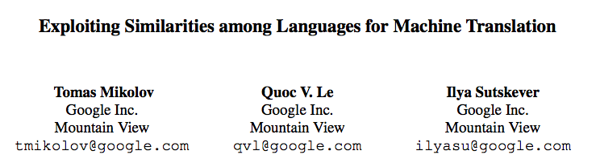
Paper 2 (2013) - Supervised MWE
Notes:
Cross lingual dictionary as supervision.

Slide 25
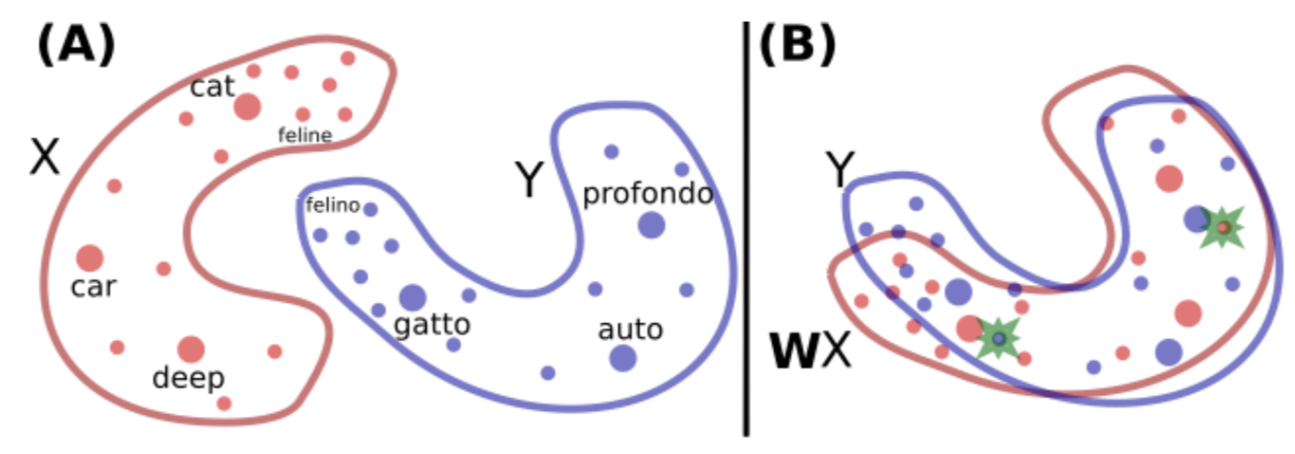
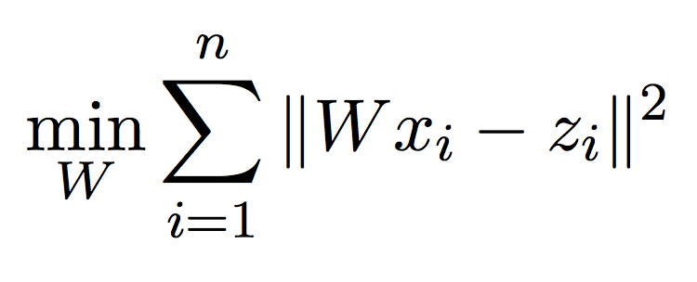
Paper 2 - Linear mapping between embeddings (slide from Rui Zhang)
https://arxiv.org/pdf/1710.04087.pdf
Notes:
Adapted from Rui

Slide 26
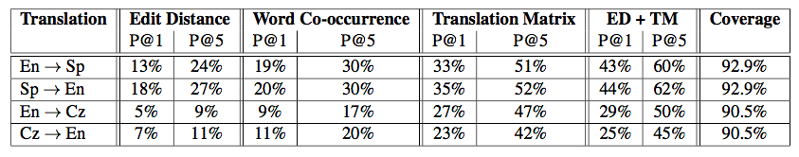
Paper 2: results

Slide 27
Supervised MWE - Discussion
How do you evaluate MWEs?
What are potential drawbacks of MultiCluster? Of Mikolov et al.’s linear mapping?
Why might we want an unsupervised approach?

Slide 28
MWE - Unsupervised

Slide 29
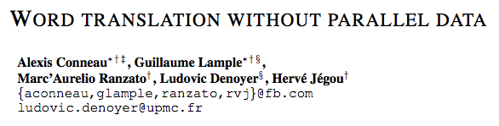
Paper 3 (MUSE, 2018) - Unsupervised BWE

Slide 30
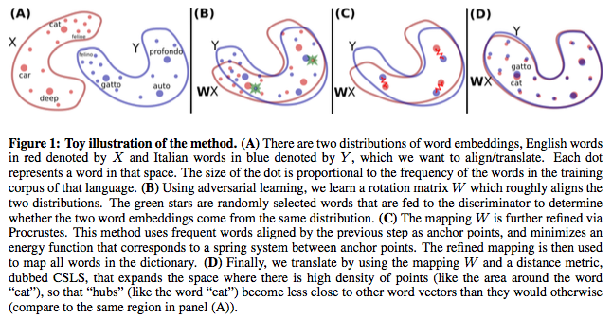
An Adversarial Two-Player Game (slides from Rui)

Slide 31
MUSE - An Adversarial Two-Player Game
WX
W: Linear Mapping
D: Discriminator
source or target?
X: source word embedding
Y: target word embedding

Slide 32
MUSE - An Adversarial Two-Player Game
Discriminative Objective
Distinguish between WX and Y
Linear Mapping Objective
WX is close to Y such that the discriminator cannot distinguish between WX and Y

Slide 33
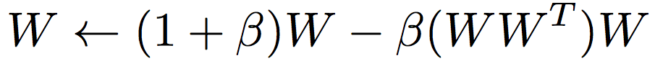
MUSE - Orthogonality

Slide 34
MUSE - Mapping between Two Embedding Spaces
https://code.fb.com/ai-research/unsupervised-machine-translation-a-novel-approach-to-provide-fast-accurate-translations-for-more-languages/

Slide 35
MUSE - Refinement procedure
Choose anchor points for a synthetic lexicon
Learn a linear map as in Mikolov et al. (2013). (See previous)
Anchor points are mutual nearest neighbors via CSLS distance metric. Intuition: mutual nearest neighbors => more confident in the translation; a smaller, more accurate dictionary will work best for this step.
The anchor points can change as the refinement progresses (the refined mapping can closely align words that were distant previously).
Notes:
Question: use mutual nearest neighbors rather than CSLS? Even more confident in the mapping, then.

Slide 36
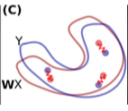
Refinement procedure - visual
Notes:
Question: use mutual nearest neighbors rather than CSLS? Even more confident in the mapping, then.

Slide 37
MUSE - Word Translation
Problem with Euclidean distance metric: Hubbness

Slide 38
MUSE - Word Translation
Problem with Euclidean distance metric: Hubbness
Euclidean one-nearest-neighbors translation
= No translation, or asymmetric translation

Slide 39
MUSE - Word Translation
Problem with Euclidean distance metric: Hubbness
De-Hubbed one-nearest-neighbors translation
Notes:
If r_T is high, that means it is hubby.
Example: suppose both r_Ts are high. They’re likely in a hub together, and thus are less similar to each other.

Slide 40
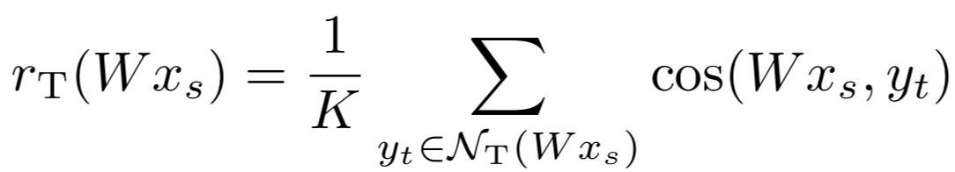
MUSE - Word Translation
Problem with Euclidean distance metric: Hubbness
De-Hubbed one-nearest-neighbors translation
Hubbiness measure
Notes:
If r_T is high, that means it is hubby.
Example: suppose both r_Ts are high. They’re likely in a hub together, and thus are less similar to each other.

Slide 41
MUSE - Word Translation
Problem with Euclidean distance metric: Hubbness
De-Hubbed one-nearest-neighbors translation
Hubbiness measure
De-Hubbed distance metric
Notes:
If r_T is high, that means it is hubby.
Example: suppose both r_Ts are high. They’re likely in a hub together, and thus are less similar to each other.

Slide 42
MUSE - Word Translation
Can we do even better?

Slide 43
MUSE - Word Translation
Can we do even better?
Stable matching algorithm?
Con: O(n^2) vs. fast approximate KNN

Slide 44
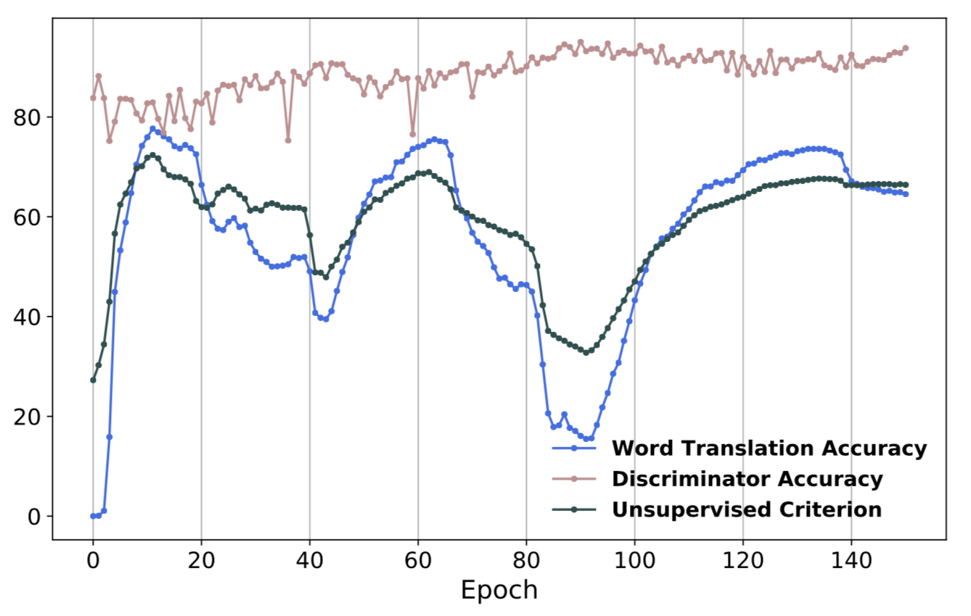
MUSE - Unsupervised Model Selection
The validation criterion is also unsupervised.
Cannot use bilingual aligned data for stopping the train or hyperparameter selection.
Use 10K most frequent source words and generate a translation using CSLS.
Use their cosine similarity as a surrogate validation metric.
This metric correlates well with the word translation accuracy (see figure).
Notes:
Intuition: when the translations are good, there is high cosine similarity between the proposed translations.

Slide 45
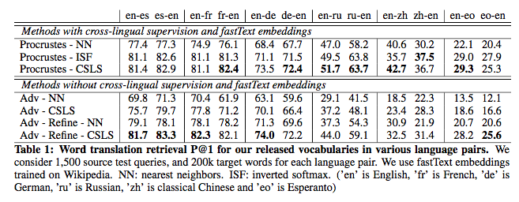
MUSE - Results

Slide 46
How to extend MUSE from BWE to MWE?
What are some simple ways to extend MUSE to a multilingual setting?

Slide 47
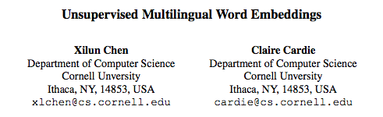
Paper 4 (2018) - Unsupervised MWE

Slide 48
Extend MUSE to MWE
BWE-Pivot
BWE-Direct

Slide 49

BWE-Pivot

Slide 50
BWE-Pivot: Shortcomings?

Slide 51
BWE-Pivot: Shortcomings
Similar languages like French and Italian converted into a less similar language like English => lower quality MWEs.

Slide 52
BWE-Direct

Slide 53
BWE-Direct: Shortcomings?

Slide 54
BWE-Direct: Shortcomings?
Runtime: For N languages, N choose 2 pairs => O(N^2) training.
Quality: Translating French to Italian, other romance languages like Spanish can add information and improve embeddings.

Slide 55
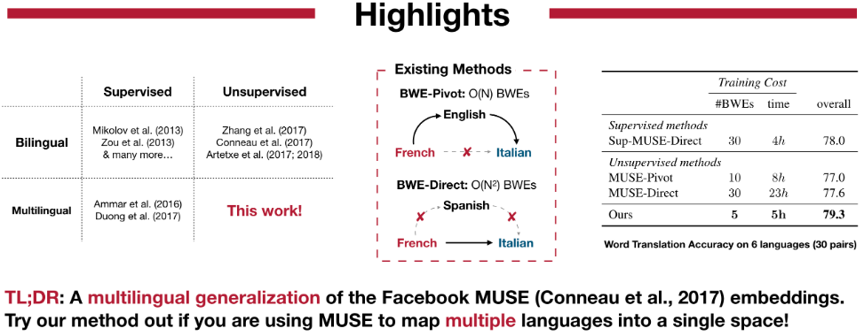
Paper 4: Major contributions
https://github.com/ccsasuke/umwe

Slide 56
Paper 4: Major contributions
MAT algorithm extends MUSE-style adversarial training
MPSE algorithm extends MUSE anchor-points
Unsupervised Multilingual Validation extends MUSE unsupervised validation

Slide 57
Paper 4: MAT
Analogous to MUSE linear mapping between source and target to fool a discriminator.
Many languages take turns acting as source and target; each have their own map and discriminator.

Slide 58
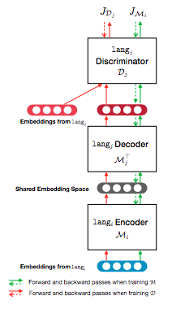
MAT: Architecture
One discriminator per language differentiates embeddings from the language vs. those “converted” from another.
“Conversion” involves mapping to a shared space, then inverting the target language’s encoder to decode into the target embedding space.
A good encoder helps other decoders fool their discriminators, and (when inverted) decodes the output of other encoders fool its own discriminator.

Slide 59
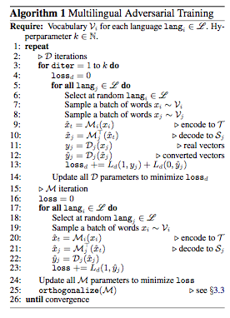
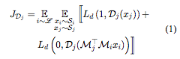
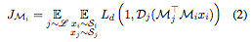
MAT: Objective and training

Slide 60
MAT: Objective and training

Slide 61
MAT: Objective and training

Slide 62
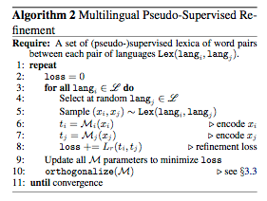
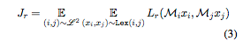
MPSR: Objective and training

Slide 63
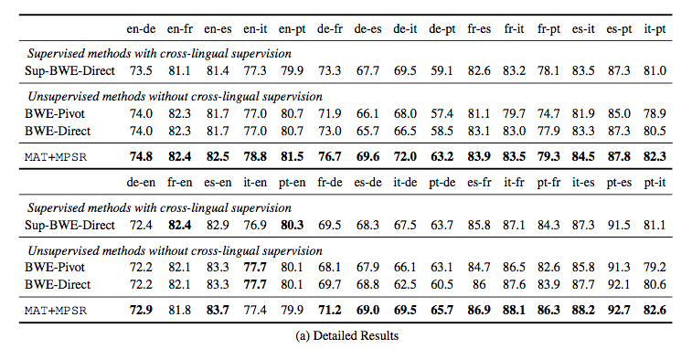
Paper 4: Results
Notes:
Direct improves over pivot => less similar langs hypothesis
Their alg improves over direct => bridge langs hypothesis

Slide 64
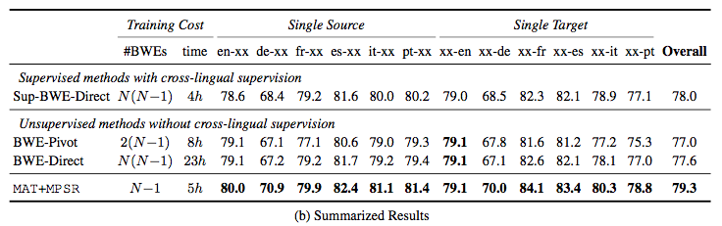
Paper 4: Results
Notes:
Training time: Going both ways improve performance

Slide 65
Unsupervised MWE - Discussion
Why have unsupervised MWE techniques become the new SOTA? When might supervised or semi-supervised MWE techniques be better?
What does the fact that unsupervised machine translation is possible say about languages in general?
Should MWEs techniques seek to do more than just multiple bilingual word embeddings? Why?
What is the hubbness problem? Is it such a problem to have asymmetric translations?
Should Google translate start using bridge languages in translation?

Slide 66
Conclusion
Multilingual embeddings
Supervised
Massively Multilingual Word Embeddings, 2016
Exploiting Similarities among Languages for Machine Translation, 2013
Unsupervised
MUSE, 2018
Unsupervised Multilingual Word Embeddings, 2018

Slide 67
Discussion Questions
What research ideas can you think of that improve MWEs or use them to improve other tasks?
Monolingual embedding techniques have been influential outside of NLP, in areas like genetics and economics. What research outside of NLP can benefit by analogy to MWE?
Do you think learning multiple languages for humans is more supervised or unsupervised?
What might recent unsupervised results advocate for language learning in schools?
Notes:
1 - Multilingual sentence embeddings?
2 - Transfer learning what someone has bought to what they will buy in a different market; Animals in the same species are documents, animals in different species are languages
3 - Immersion settings are interesting. There is extra-lingual supervision, but not in the source language. Semi-supervised? Could extra-lingual supervision such as captions on pictures in another language be useful? Facebook posts?

Slide 68
Discussion Questions, cont’d
Must translations be symmetric? Do translations tend to be symmetric from human translators? Are there limits to the noisy channel model?
Will translating into English to solve NLP tasks remain paradigmatic?
Translation is better, but so is our ability to avoid the need for highly-engineered parsers, etc.
Can any methods we’ve seen address the linguistic task of determining language inheritance?
Notes:
1 - Saudade == melancholic longing, nostalgia; claimed as untranslatable

Slide 69
Untranslatable?
Godel, Escher, Bach - Douglass R. Hofstadter
Notes:
1 - Saudade == melancholic longing, nostalgia; claimed as untranslatable

Slide 70
Other Papers
A robust self-learning method for fully unsupervised cross-lingual mappings of word embeddings
Adversarial Training for Unsupervised Bilingual Lexicon Induction
Learning Multilingual Word Embeddings in Latent Metric Space: A Geometric Approach
Learning Multilingual Embeddings for Cross-Lingual Information Retrieval in the Presence of Topically Aligned Corpora
Elmo, GloVe, Word2Vec
Vision as an Interlingua: Learning Multilingual Semantic Embeddings of Untranscribed Speech

Slide 71
Other Resources
MWE survey: http://ruder.io/cross-lingual-embeddings/
Stony Brook's polyglot http://tangra.cs.yale.edu/newaan/index.php/resource/visit/2683
MUSE http://tangra.cs.yale.edu/newaan/index.php/resource/visit/64141
https://ai.googleblog.com/2015/06/a-multilingual-corpus-of-automatically.html

Slide 75
Word Translation
Produce reliable mapping between two languages based on Cosine Similarity
Symmetric: If word y in target is the NN of word x in source, we also want to have x in source is the NN of word y in target.
Notes:
If r_T is high, that means it is hubby.
Example: suppose both r_Ts are high. They’re likely in a hub together, and thus are less similar to each other.

Slide 76
Paper 1 - evaluation
QVEC
Downstream tasks
Document classification
Dependency parsing

Slide 77
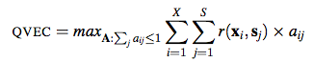
Evaluation: QVEC
QVEC: maximize aligned correlation between learned embeddings and semantic vectors. Correlates well with downstream tasks.

